Slide 1
Reflection of Light
The phenomenon by which a ray of light changes the direction of propagation when it strikes a boundary between different media through which it cannot pass is described as the reflection of light.

Slide 2
Spherical Mirrors
A mirror whose polished, reflecting surface is a part of a
hollow sphere of glass or plastic is called a spherical mirror.
In a spherical mirror, one of the two curved surfaces is coated with a thin layer of silver followed by a coating of red lead oxide paint. Thus, one side of the spherical mirror is opaque and the other side is a highly polished reflecting surface
Depending upon the nature of the reflecting surface of a
mirror, the spherical mirror is classified as:
Concave Mirror: Concave mirror is a spherical mirror whose reflecting surface is towards the centre of the sphere of which the mirror is a part.
Convex Mirror: Convex mirror is a spherical mirror whose reflecting surface is away from the centre of the sphere of which the mirror is a part.

Slide 3
Parts of spherical mirror
Centre of Curvature is the centre of the sphere of which the spherical mirror forms a part. It is denoted by the letter C.
Radius of Curvature is the radius of the sphere of which the mirror is a
part. It is represented by the letter R.
Linear aperture is the distance between the extreme points (X and Y) on the periphery of the mirror.
Pole is the midpoint of the aperture of the spherical mirror. It is represented by the letter P.
Principal axis is the straight line passing through the pole and the centre of curvature of a spherical mirror.
Principal Focus or Focus-The rays of light parallel to the principal axis of a mirror after reflection, either pass through a point (in case of a concave mirror) or appear to diverge from a point (in the case of a convex mirror) on the principal axis and this point is referred to as the principal focus or focal point of the mirror.

Slide 4
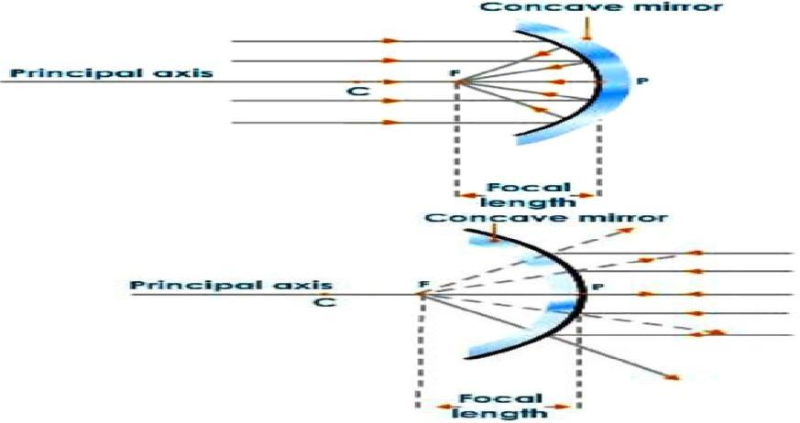

Slide 5
Image formation
Formation of an image by mirrors is usually shown by constructing ray diagrams.
To construct a ray diagram, we need at least two rays whose paths after reflection from the mirror are known.
These rays must be chosen according to our convenience. Any two of the following rays can be considered to obtain the image.

Slide 6
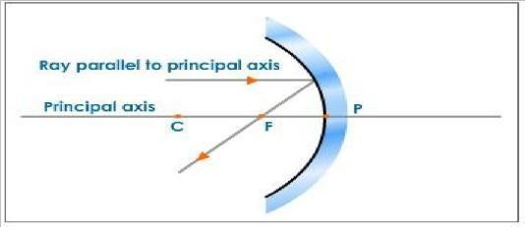
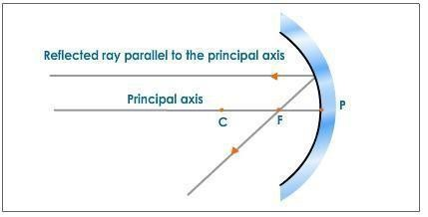
Rule 1 : A ray of light parallel to the principal axis after reflection from a concave mirror passes through its focus.
Rule 2 : A ray of light passing through the focus of a concave mirror after reflection emerges parallel to the principal axis.

Slide 7
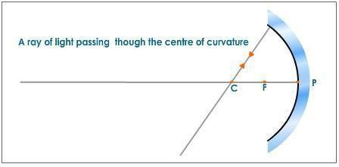
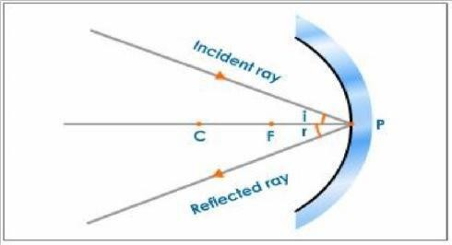
Rule 3 : A ray of light passing through the centre of curvature of a concave mirror retraces its path after reflection as the ray passing through the centre of curvature acts as a normal to the spherical mirror.
Rule 4 : A ray of light which strikes the mirror at its pole gets reflected according to the law of reflection.

Slide 8
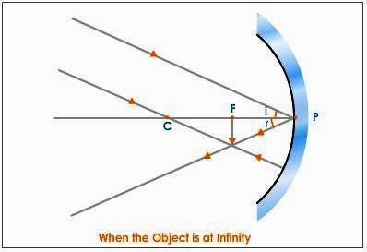
Formation of Image by a Concave Mirror
Case 1: When the Object is at Infinity
When an object is placed at infinity, the rays coming from it are parallel to each other. Let us consider two rays, one striking the mirror at its pole and the other passing through the centre of curvature.

Slide 9
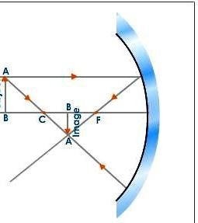
Case 2 : When the Object Is Placed Beyond C --The two rays which are considered to obtain the image are:
A ray passing through the centre of curvature. A ray parallel to the principal axis.

Slide 10
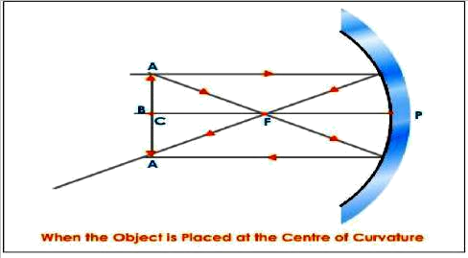
Case 3 : When the Object Is Placed At the Centre of Curvature
We consider the two rays, one parallel to the principal axis and the other passing through the focus.

Slide 11
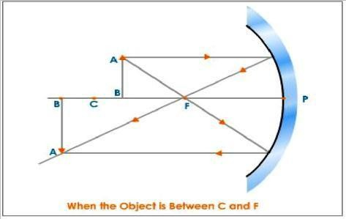
Case 4 : When the Object Is Between C and F
We consider a ray of light which is parallel to the principal axis and another ray passing through the focus.

Slide 12
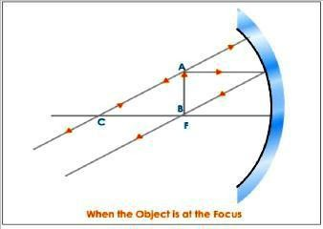
Case 5 : When the Object Is at the Focus
Here, we consider a ray of light which is parallel to the principal axis and another ray passing through the centre of curvature.

Slide 13
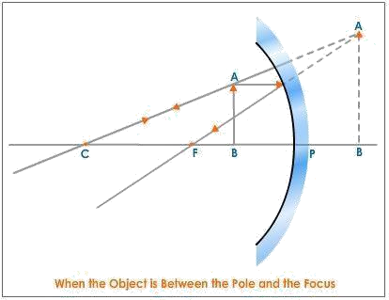
Case 6: When the Object Is Between the Pole and the Focus
Here we consider a ray of light which is parallel to the principal axis and another ray which is passing through the centre of curvature.

Slide 14
Uses of Concave Mirrors
As reflectors in the head lights of cars, search lights in torches etc. to obtain a parallel beam of light. For this, the source of light is placed at the focus of the concave reflector.
By dentist to focus light on the tooth to be examined.
As shaving mirrors and as make up mirrors to get an enlarged erect image of the face
To concentrate solar radiations in solar heating devices. For this the food or substance that has to be heated is placed at the focus of a large concave reflector. After reflection, sun light converges on the substance and heats it.

Slide 15
Table summarizing the various characteristics if image obtained by concave mirror when placed at different positions:
Position of the | Position of the | Nature and size | Use
image | object | of the image
At infinity | At the focus | Real, Inverted and | Used by ENT Surgeons and
 |  | diminished | dentists
Beyond the center | Between the focus | Real, Inverted and | Used in solar cookers
of curvature | and the centre of | diminished
 | curvature
At the center of | At center of | Real, Inverted and | Used as an Erecting mirror
curvature | curvature | same size as object | in terrestrial telescopes
Between the focus | Beyond the centre | Real, inverted and | Used in hospitals and clinics
and center of curvature | of curvature | magnified | to see the internal parts of
 |  |  | the body
At focus | At infinity | Real, inverted and | Used in search lights and
 |  | magnified | in head lights of motor cars
Between the pole | Appears behind the | Virtual, erect and | Used as a shaving mirror
of the mirror and | mirror | magnified
the focus

Slide 16
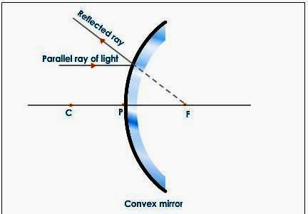
Convex Mirror
The following rays are considered while constructing ray diagrams.
Rule 1: A ray of light travelling parallel to the principal axis after reflection from a convex mirror appear to come from its focus behind the mirror.
Rule 2: A ray of light incident obliquely to the principal axis, towards the pole of the mirror gets reflected according to the laws of reflection.

Slide 17
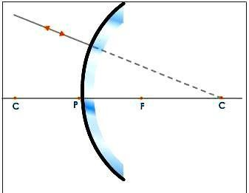
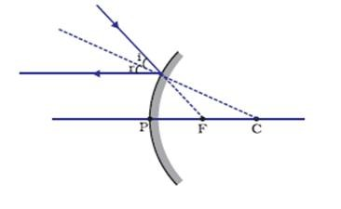
Rule 3 : A ray of light traveling towards the centre of curvature behind the mirror hits the mirror at 90º and is reflected along its path.
Rule 4: A ray of light which is directed towards the principal focus of a convex mirror, after reflection will emerge parallel to the principal axis.

Slide 18
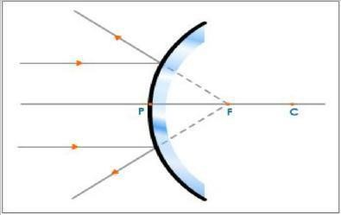
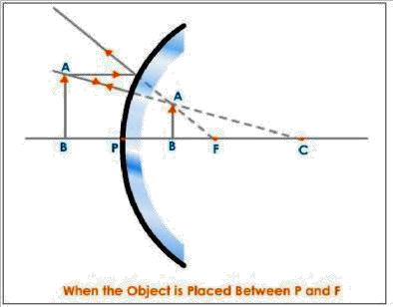
Formation of Image in a Convex Mirror
Case 1: When the Object Is Placed Between Infinity and the Pole of the Mirror
Case 2 : When the Object Is At Infinity

Slide 19
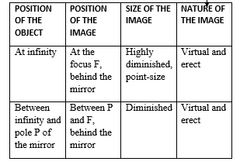
Table summarizing the various characteristics if image obtained by convex mirror when placed at different positions:

Slide 20
Uses of Convex Mirror
Rear-view mirror in an automobile. This convex mirror gives the driver a clear view of the traffic approaching from behind as convex mirrors are curved outwards giving a wider field of view.
Vigilance mirror in departmental stores
Reflector in street lamps so as to diverge the light over a large area

